Slide 1
Module 2 Project
EDA on Airbnb booking
by
ATUL SINGH

Slide 2

Problem Statement
For this project we are analyzing Airbnb’s New York City(NYC) data of 2019. NYC is not only the most famous city in the world but also top global destination for visitors drawn to its museums, entertainment, restaurants and commerce.
Our main objective is to ﬁnd out the key metrics that inﬂuence the listing of properties on the platform. For this, we will explore and visualize the dataset from Airbnb in NYC using basic exploratory data analysis (EDA) techniques.
Data analysis on thousands of listings provided through Airbnb is a crucial factor for the company.
We will be ﬁnding out the distribution of every Airbnb listing based on their location, including their price range, room type, listing name, and other related factors.

Slide 3

Understanding the Data
There are 49,000 observations with various types of field in our dataset.
List of field:
Id
Name
Host_id
Host_name
Neighbourhood_group
Neighbourhood
Latitude
Longitude
Room_type
Price
Minimum_nights
Number_of_reviews
Last_review
Reviews_per_month
Calculated_host_listing_count
availabilty_365

Slide 4

Agenda
We try to answer following questions for Airbnb:
What is the average preferred price by customers according to the location?
Number of active hosts per location (Where most of the hosts focused to own property?)
Where the customer pays the highest and lowest rent according to location?
Most popular/demanded host of Airbnb in New York
Find the total count of each room type

Slide 5

Agenda(Cont...)
Room types and their relation with availability in different neighbourhood groups?
Which are the top 25 most used words in listing names?
Find top 10 hosts with most listings
Find the top three hosts based on their turnover
Find total no. of nights spend per location
Total no. of nights spends per room types
Top 10 highest listing neighborhood

Slide 6
Map of New York City(NYC)

Slide 7
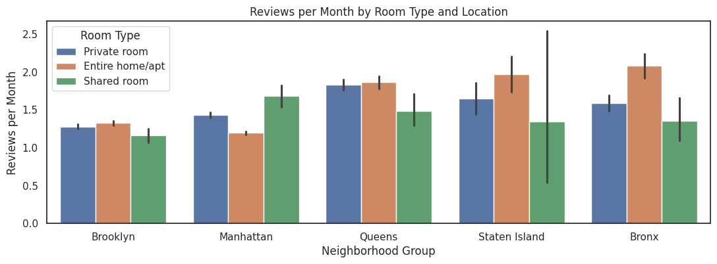
What is the average preferred price by customers according to the location?
As we can see in Manhattan average price of Entire home/apt is highest, compared to other location.
Average price of shared room is lowest in brooklyn.
Queens, Staten Island and Bronx share almost the same price i.e $50 for Shared room and Private room.

Slide 8
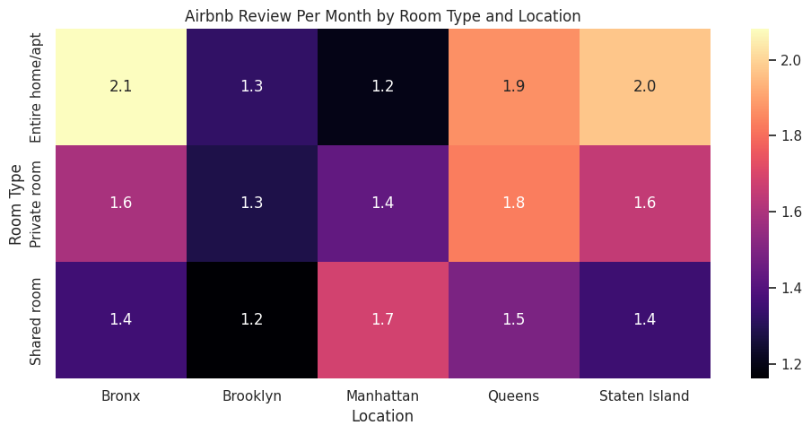
What is the average preferred price by customers according to the location?
As we can see in Manhattan average price of Entire home/apt is highest, compared to other location.
Average price of shared room is lowest in brooklyn.
Queens, Staten Island and Bronx share almost the same price i.e $50 for Shared room and Private room.

Slide 9
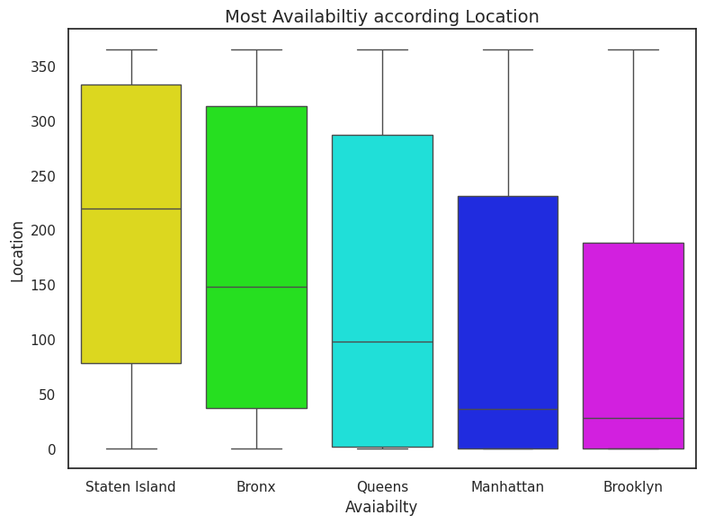
Which Location have most Availability ?
Overall, this visualization provides insights into the distribution of Airbnb listing availability across various boroughs in NYC, aiding in understanding the rental market dynamics in different areas.

Slide 10
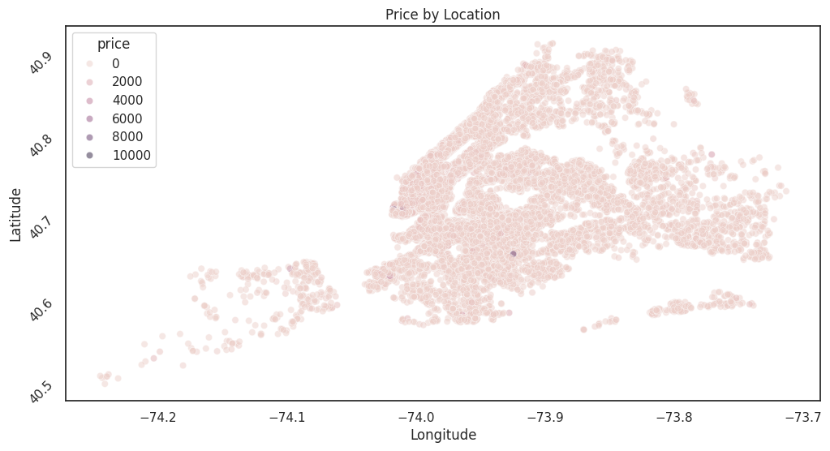
which Area according price is more preferable using longitude & latitude ?
this scatter plot provides insights into the spatial distribution of Airbnb listings and how prices vary across different locations.

Slide 11
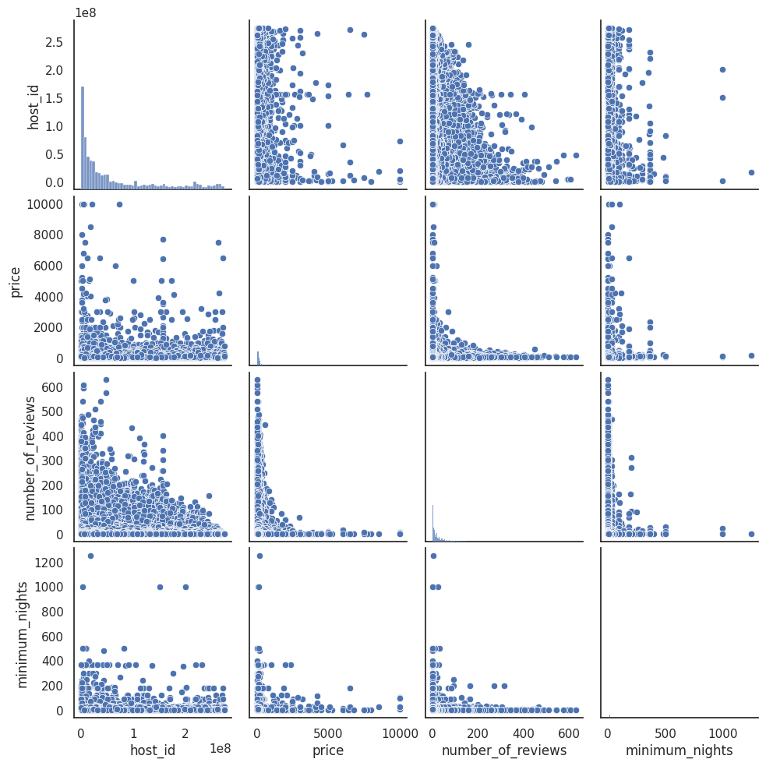
What is the relation in Host_id, price, number_of_review & minimum_nights ?

Slide 12
What is the relation in Host_id, price, number_of_review & minimum_nights ?
The scatter plots in the first row and first column show the relationship between the host ID and other numerical variables. These plots help in understanding the distribution of listings among different hosts and how it relates to other factors like price, number of reviews, and minimum nights.
The scatter plots in the third row and third column depict the relationship between the number of reviews and other numerical variables. These plots help in understanding how the number of reviews correlates with variables like price, host ID, and minimum nights.
The scatter plots in the second row and second column show the relationship between price and other numerical variables. These plots provide insights into how the price of listings varies with factors such as host ID, number of reviews, and minimum nights.
The scatter plots in the fourth row and fourth column illustrate the relationship between the minimum nights required for booking and other numerical variables.

Slide 13
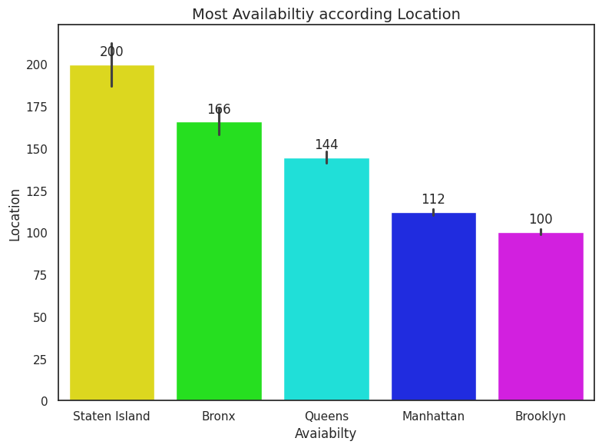
Most Availability according location
As we can see in Staten Island is less demanding and most availability .
Brooklyn has least availability due to its high bookings.

Slide 14
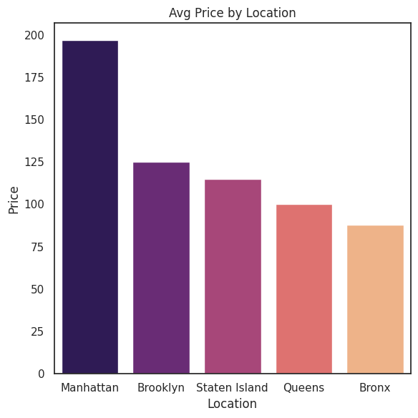
Where does the customers pay the Avg rent according to location?
AirBNB rentals across the five boroughs are 197/night in Manhattan.
125/night in Brooklyn, .
115/night in Staten Island, .
100/night in Queens.
and 80/night in the Bronx.

Slide 15
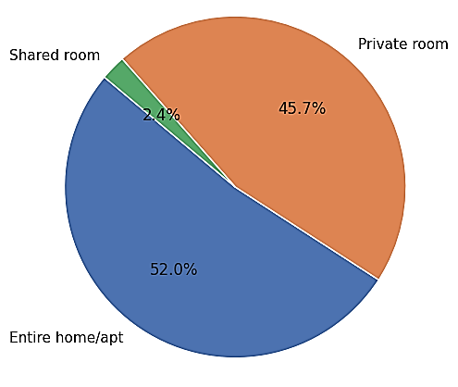
Total count of each room type as per listing.
Based on the Analysis we found that:
Entire home/apt has the highest number of listing of 52% among other room types.
Private room has 45.7% of listing among other room types.
Shared Room is the least listed room type at only 2.4% in total.

Slide 16
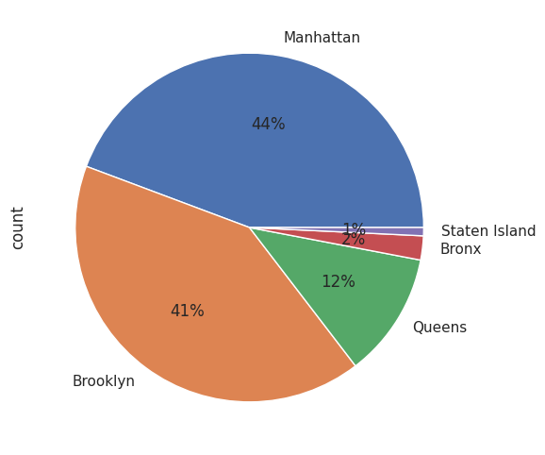
AirBNB rentals distributed among the five boroughs of New York?
Based on the Analysis we found that:
Manhattan has the highest number of listing of 44% among other boroughs.
Brooklyn has 41% of listing among other boroughs.
Queens has listed at only 12% in total.
Bronx & Staten Island has the least listed at only 2% & 1% in total.

Slide 17
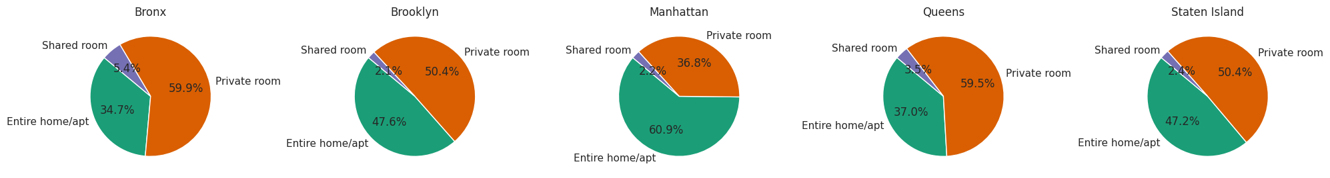
Room types and their relation with availability in different neighbourhood groups?
As we can see every neighbourhood group is dominated by the private room type at around 55%.

Slide 18
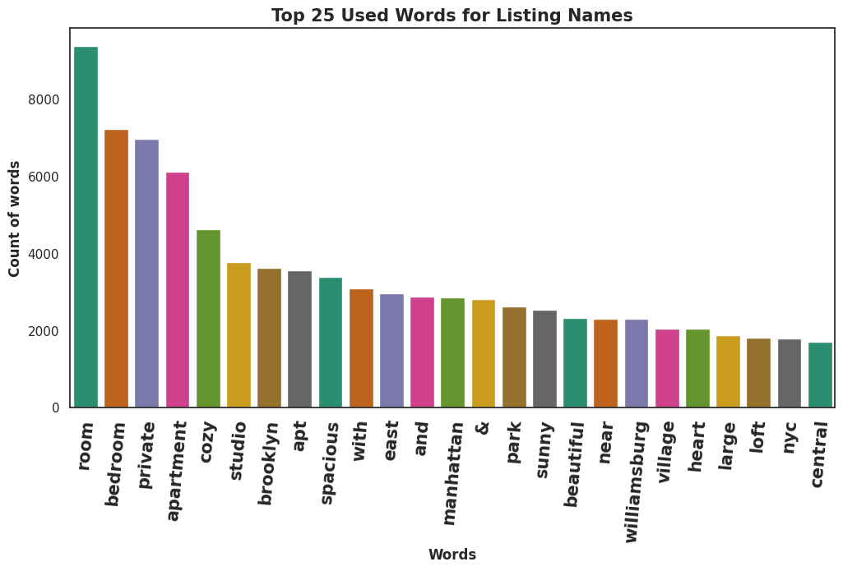
Top 25 most common words used in listing names

Slide 19
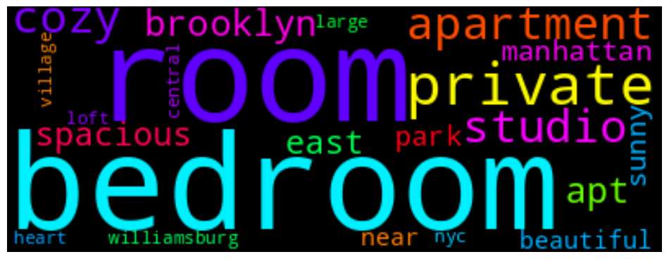
Top 25 most common words used in listing names (contd.)
❏ As we can see most of the listing names include words related to property type such as ‘bedroom’, ‘cozy’, ‘private’, ‘apartment’ and ‘spacious’.
❏ It is interesting to see that words related to proximity or connection to public places such as ‘park’, ‘near’, ‘village’ and ‘heart’ rank lower in chart.

Slide 20
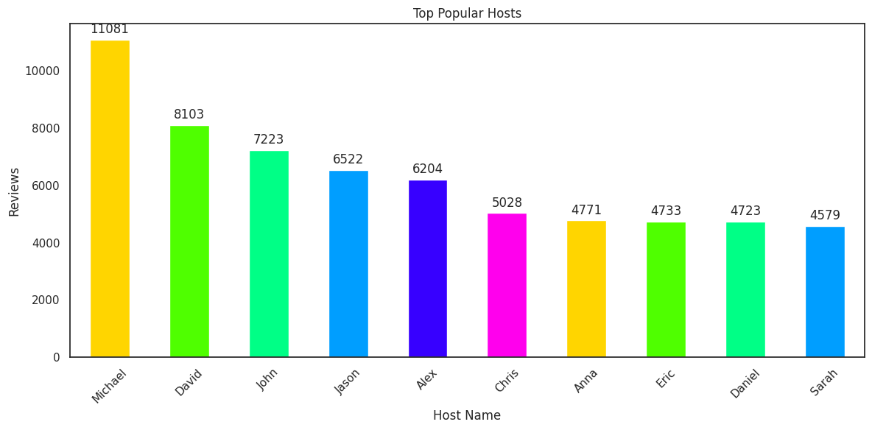
Top 10 hosts with most number of reviews

Slide 21
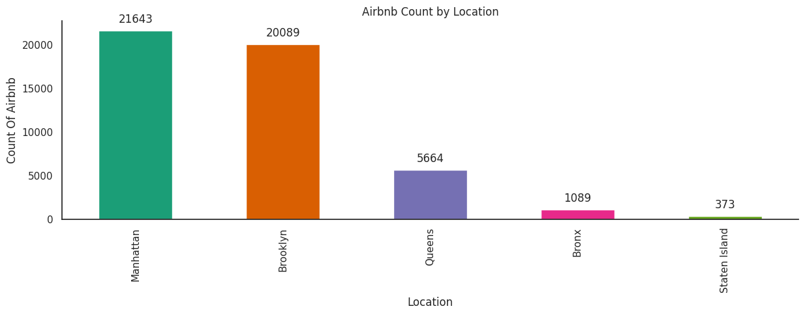
Location based Airbnb List count
Manhattan has the highest count of Airbnb listings, with approximately 21,643 listings.
Brooklyn follows Manhattan with around 20,089 listings.
Queens has fewer listings compared to Manhattan and Brooklyn, with approximately 5,664 listings.
The Bronx has the lowest count of Airbnb listings among the displayed locations, with around 1,089 listings.
Staten Island has the lowest count of Airbnb listings, with approximately 373 listings.

Slide 22

Challenges Faced
Reading the dataset and understanding the meaning of some columns.
For answering some of the questions we had to understand the business model of airbnb that how they work.
Handling NaN values,null values and duplicates.
Designing multiple visualizations to summarize the information in the dataset and successfully communicate the results and trends to the reader.

Slide 23

We defined some points which can help airbnb in their business:
Analysis Summary:
Manhattan is the most focused place in New York for hosts to do their business
Customers pay highest amount in Brooklyn,Queens and Manhattan that is $10,000 and lowest amount is
$10.
For the three types of room type (i.e. Entire home, Shared room, & Private room) average price of entire home is around $157, for Shared room is around
$60, and for private room is around $75.
Top three host base on their turnover are Sonder(nyc),Red awning, Henry and best host is Sonder(nyc)

Slide 24

Analysis Summary (contd.):
‘Entire home/apt’ room type has the highest number of listing of 52% and ‘Shared Room’ is the least listed room type at only 2.4% in total.
People stay for longer duration of time in Private rooms in Brooklyn and Manhattan.
Words such as ‘bedroom’, ‘cozy’, ‘private’, ‘apartment’ and ‘spacious’ are used more frequently than words such as ‘park’, ‘near’, ‘village’ and ‘heart’.
Count of listing by top 10 hosts is almost 2.5% (1270 listings) of the whole dataset.
More customer preferred Manhattan location for night stay than Brooklyn
63.2% customer spend night in Entire home and 1.6% spend night in Shared room

Slide 25
Thank you

